Slide 1
Making Room:
Cultivating Communities of Inclusion
Helping Churches Include Children with Disabilities
Presenter: Barbara J Newman

Slide 2

True/False Quiz

Slide 3
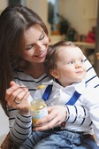
Just Try It

Slide 4
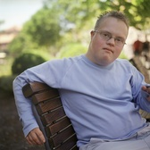
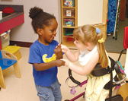
“Let the children come to me and do not hinder them for the kingdom of God belongs to such as these” Matthew 19:14

Slide 5


Three Responses
Yes
We have questions
No eye contact

Slide 6
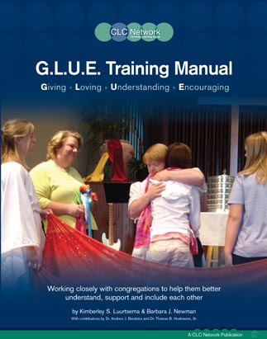
G.L.U.E. a process to help churches “just try it”

Slide 7
Six G.L.U.E. Steps
Step One: Read the Label
Awareness with Leaders
Step Two: Open the G.L.U.E.
Awareness with Others
Step Three: Discover the Possibilities
Getting to know the individual/family and the church
Step Four: Select the Right G.L.U.E.
Develop an Action Plan for individual and others
Step Five: Spread the G.L.U.E.
Share opportunities and provide trainings
Step Six: Secure the Bond
Oversee the process and recognize those involved

Slide 8
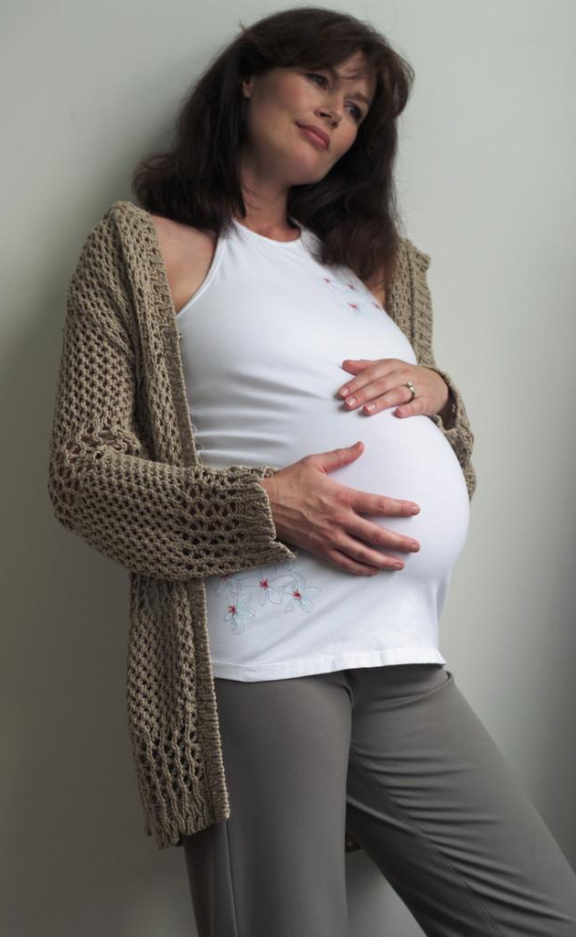
The Journey Begins
For you created my inmost being; you knit me together in my mother’s womb.
Psalm 139:13

Slide 9
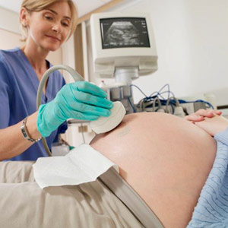
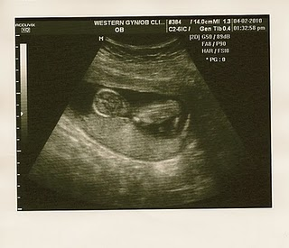
Information Before Birth

Slide 10
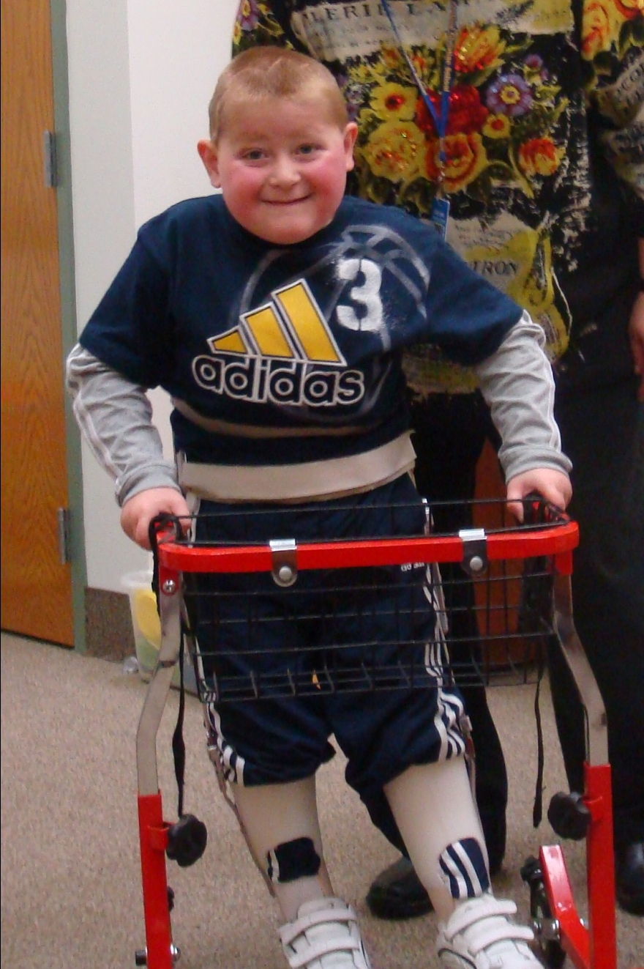
Logan

Slide 11
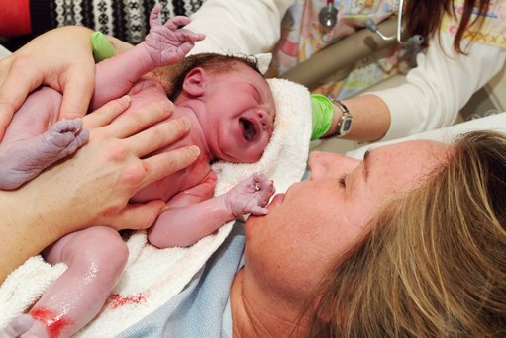
Information At Birth

Slide 12
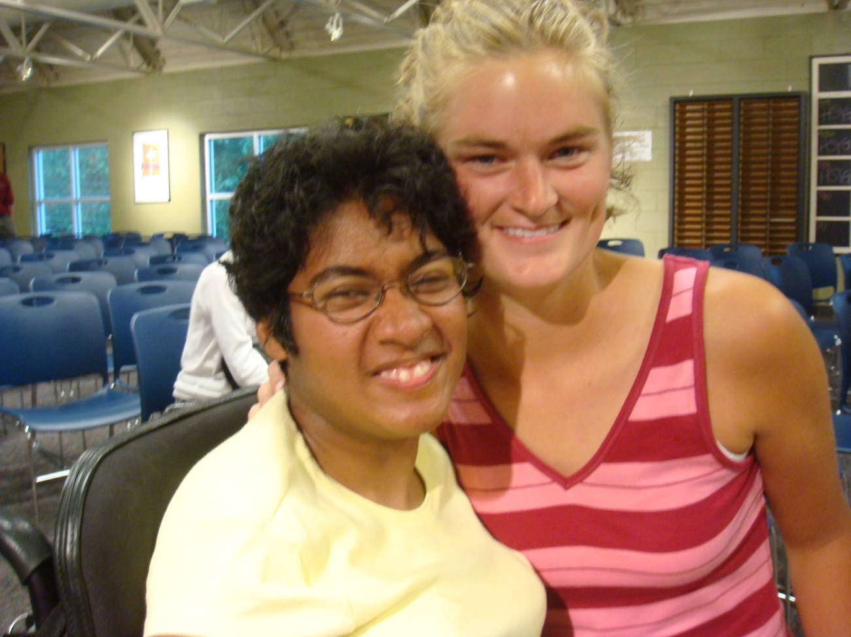
Becky

Slide 13
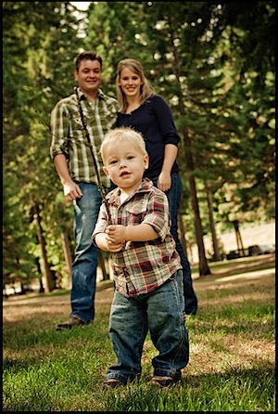
Information After Birth

Slide 14
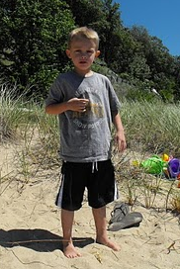
Caden

Slide 15
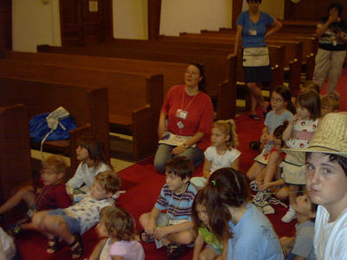
Ideas for churches involving younger years

Slide 16

1. Keep the puzzle piece perspective
  Knit Together by God
  To fill an important spot in God’s Kingdom
  Honored and important member of the body of Christ.
  Who also happens to have _________________.

Slide 17








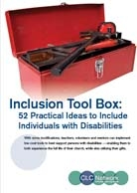
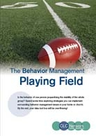
2. Gather resources prepared from a Christian perspective

Slide 18
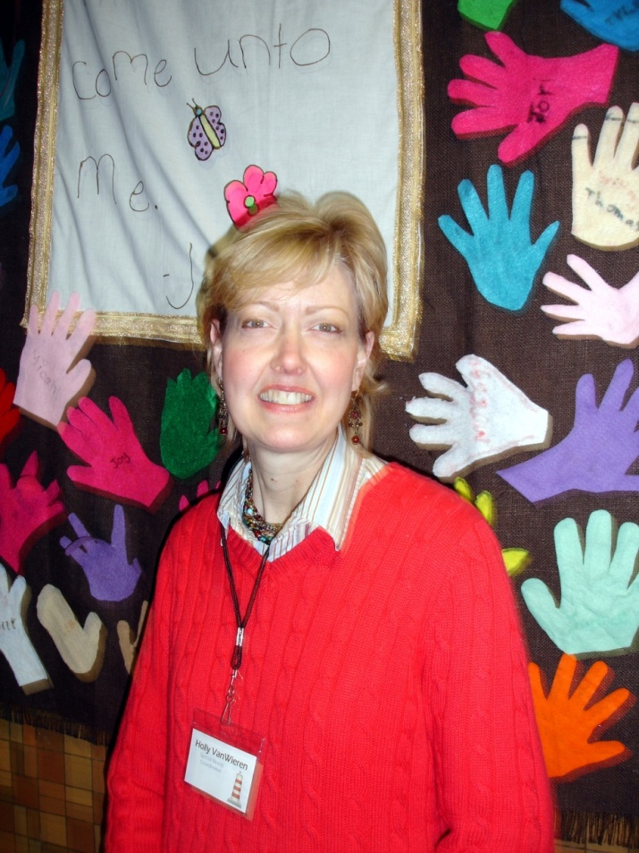
3. Appoint a good coordinator

Slide 19
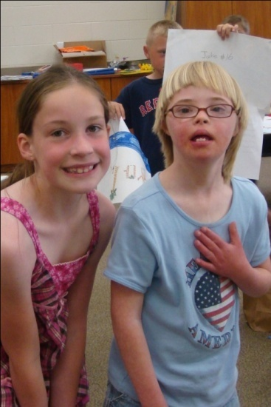
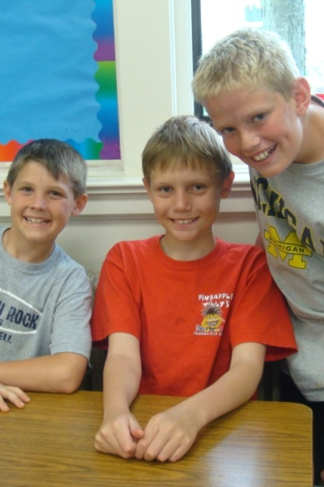
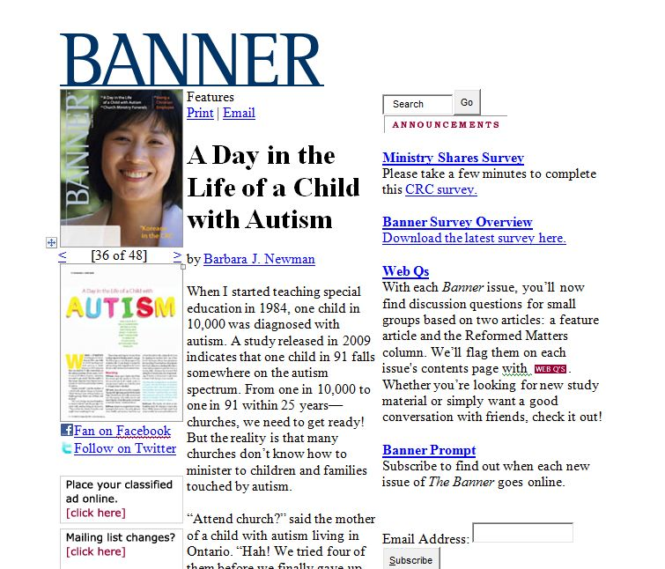
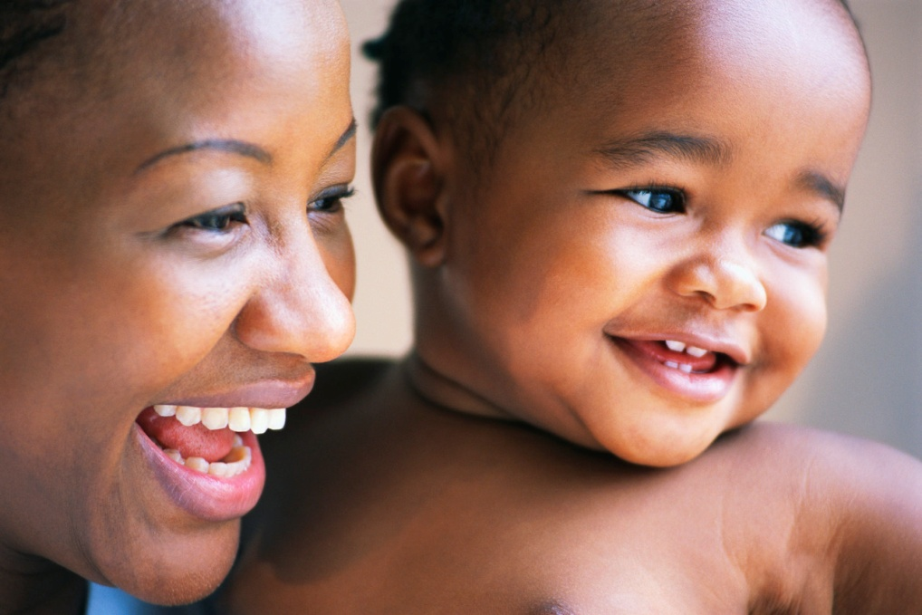
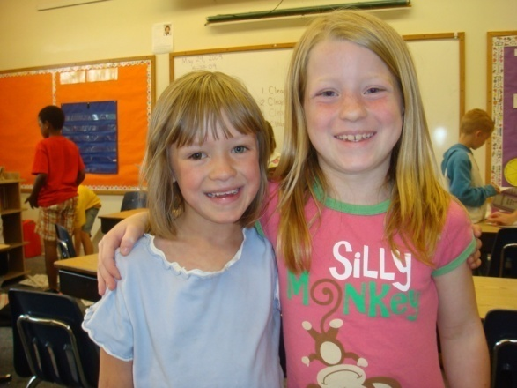
4. Get to know the child and the story

Slide 20
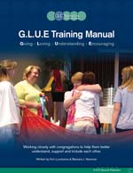
5. Develop an individualized plan
  For the family
  For the child
  For the congregation

Slide 21
6. Use the gifts and support the needs

Slide 22

Romans 15:7
Accept one another, then, just as Christ accepted you, in order to bring praise to God.
Make Heaven a Noisier Place!

